Slide 2
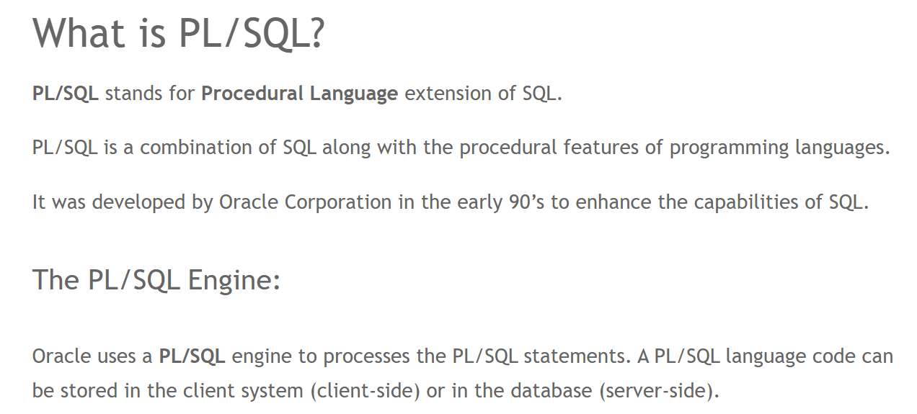

Slide 3
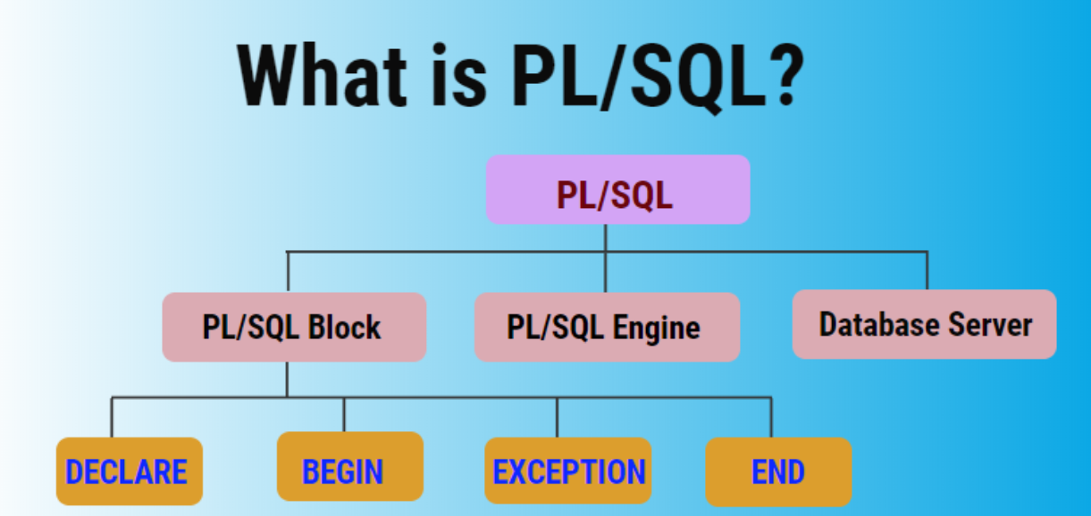

Slide 4
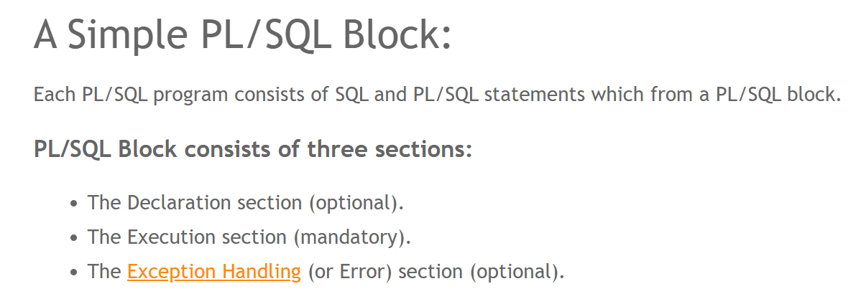

Slide 5
Declaration Section:
The Declaration section of a PL/SQL Block starts with the reserved keyword DECLARE.
This section is optional and is used to declare any placeholders like variables, constants, records and cursors, which are used to manipulate data in the execution section. Execution Section:
The Execution section of a PL/SQL Block starts with the reserved keyword BEGIN and ends with END.
This is a mandatory section and is the section where the program logic is written to perform any task.
The programmatic constructs like loops, conditional statement and SQL statements form the part of execution section. Exception Section:
The Exception section of a PL/SQL Block starts with the reserved keyword EXCEPTION.
This section is optional. Any errors in the program can be handled in this section, so that the PL/SQL Blocks terminates gracefully.

Slide 6
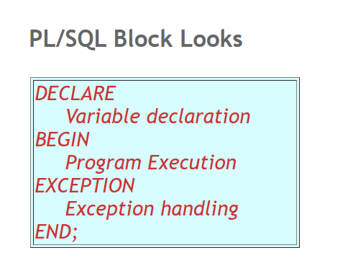

Slide 7
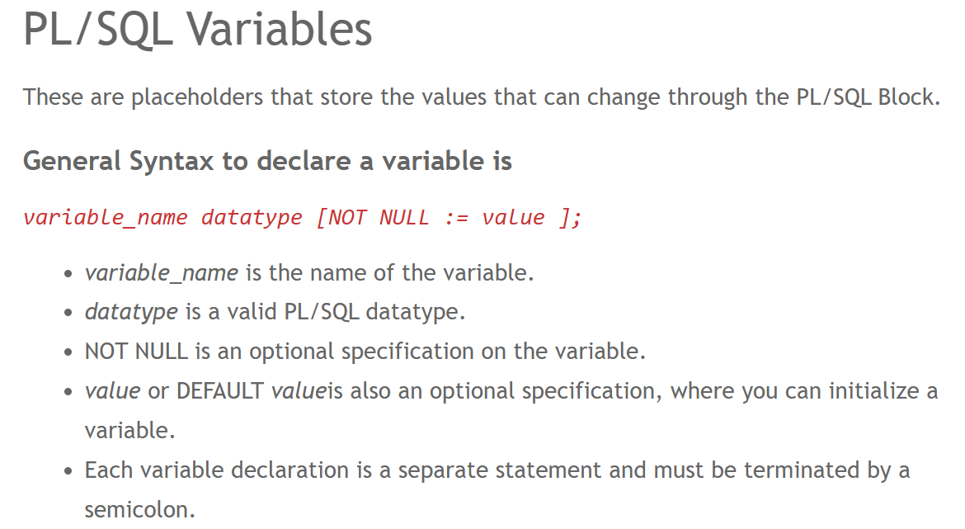

Slide 8
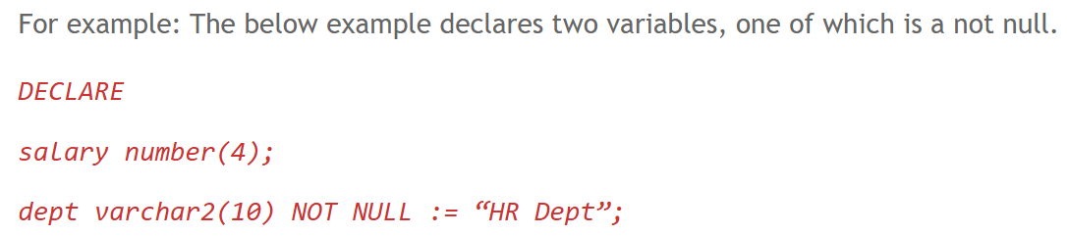

Slide 9
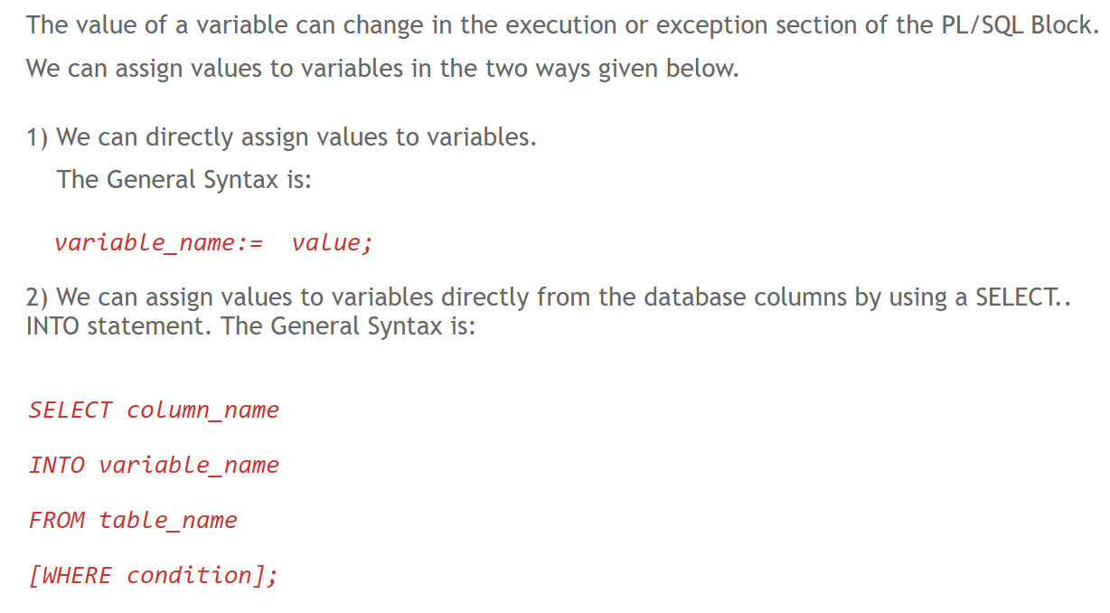

Slide 11
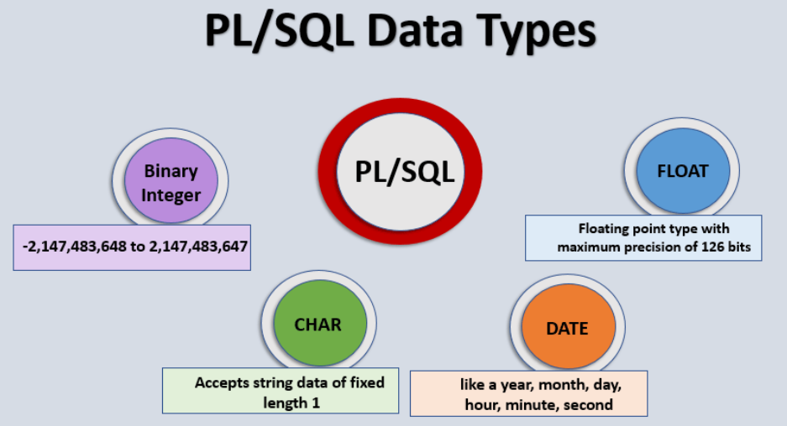

Slide 12

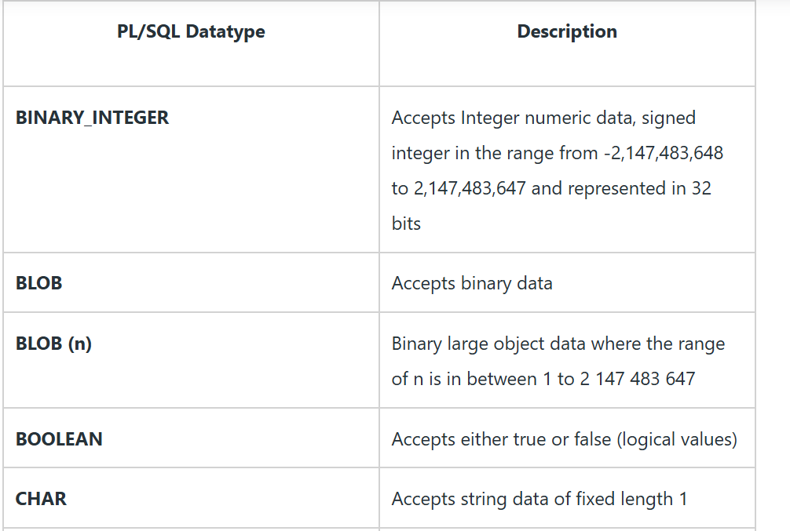

Slide 13
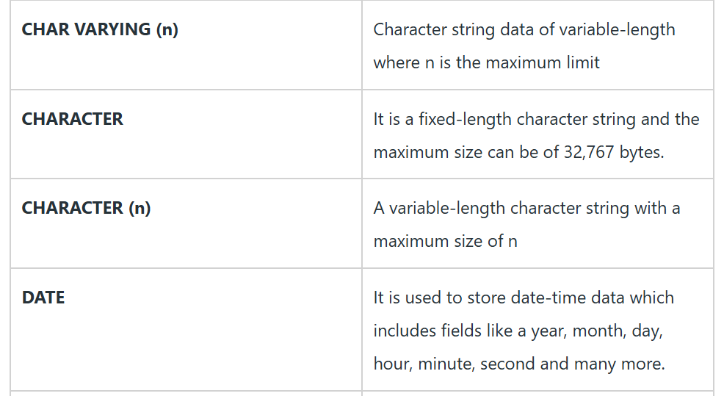

Slide 14
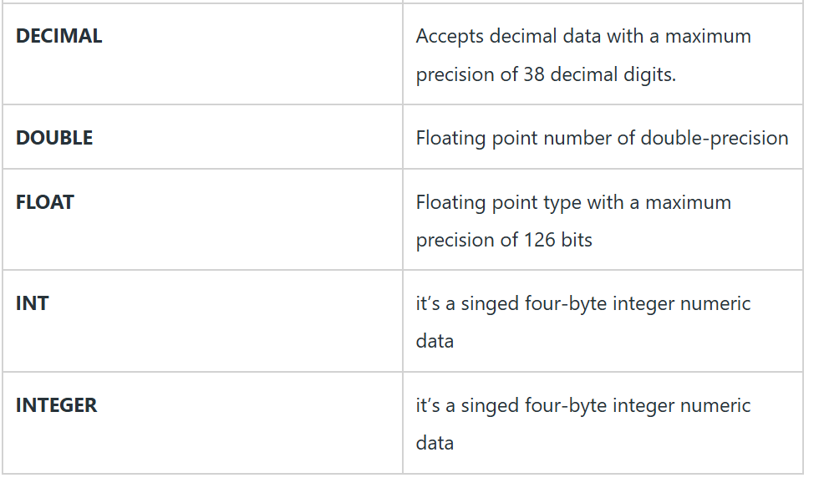

Slide 15
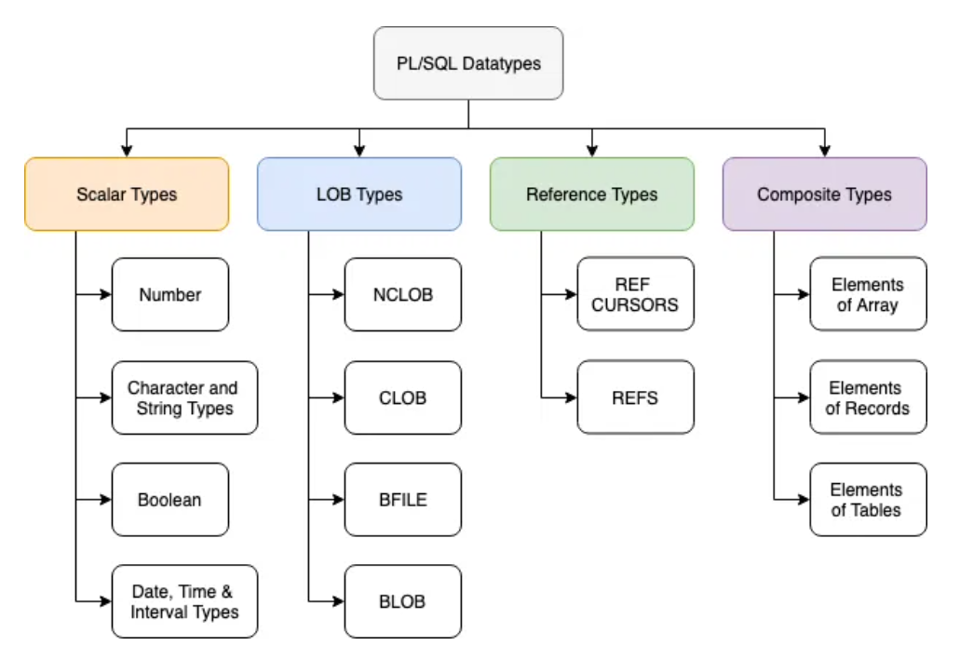

Slide 16
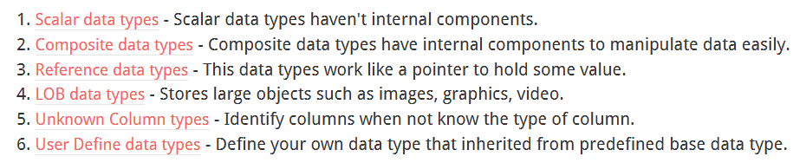

Slide 18
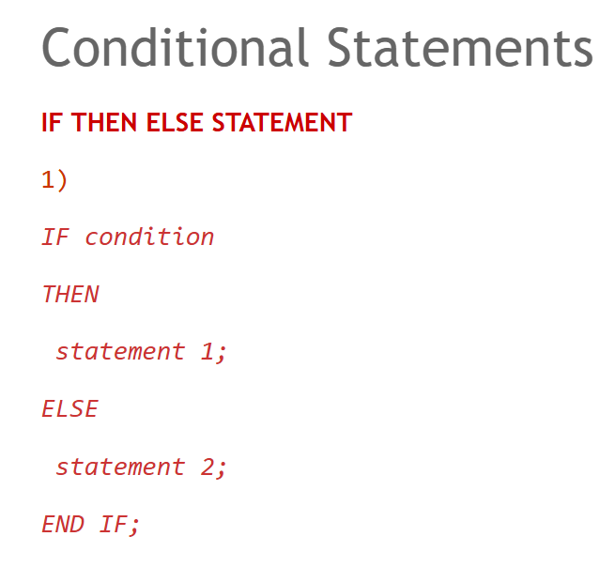

Slide 19
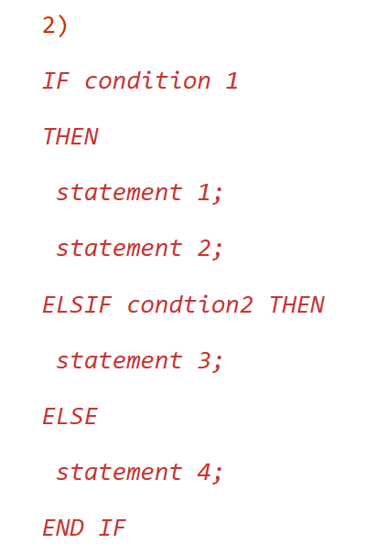

Slide 20
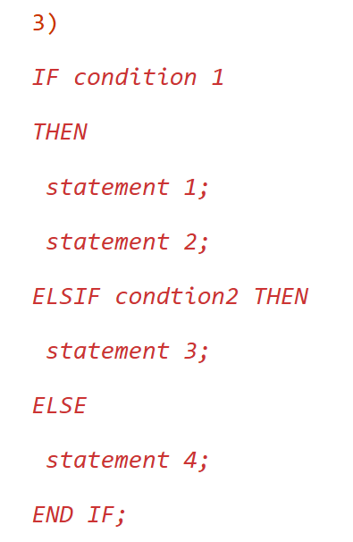

Slide 21
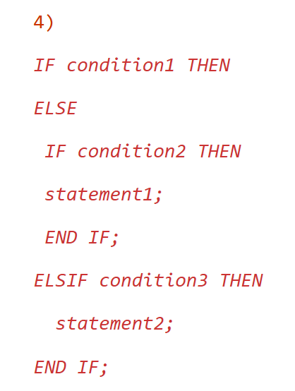

Slide 22
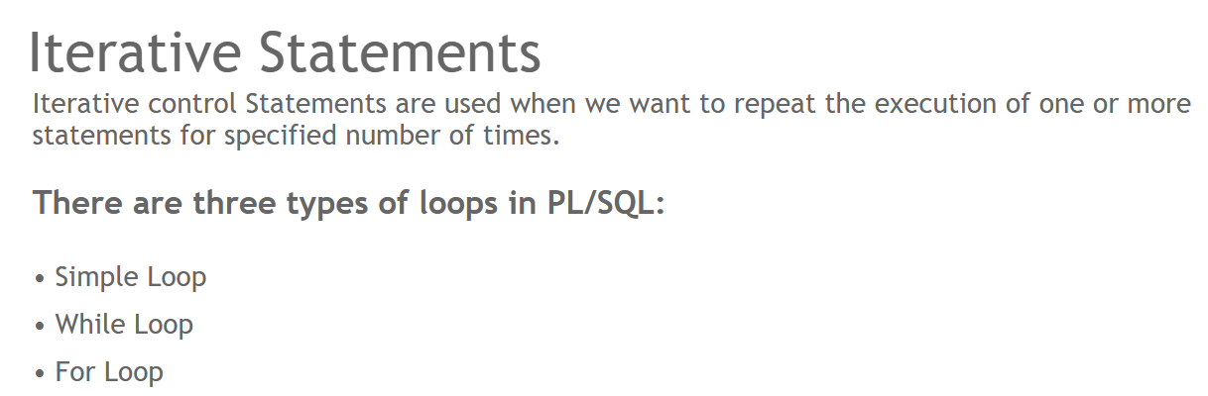

Slide 23
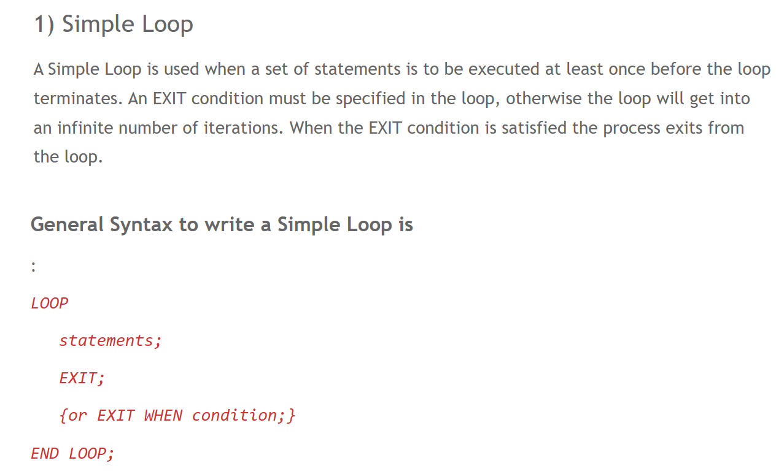

Slide 24
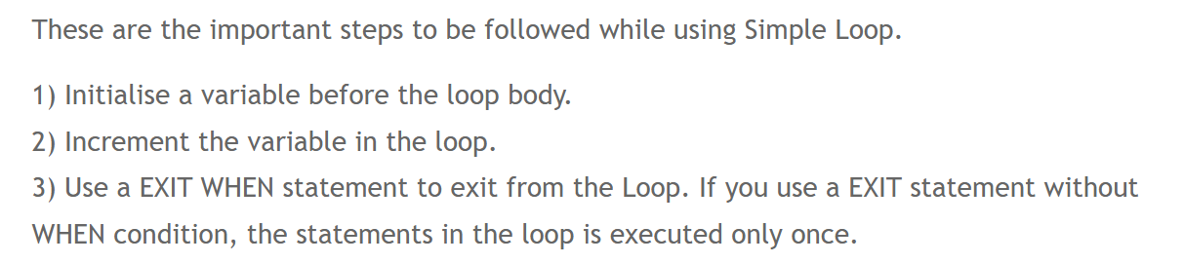

Slide 25
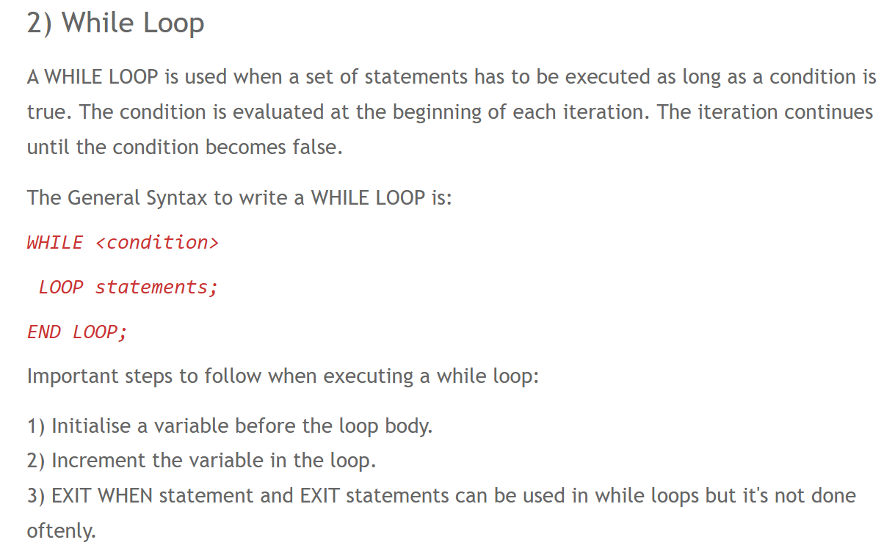

Slide 26
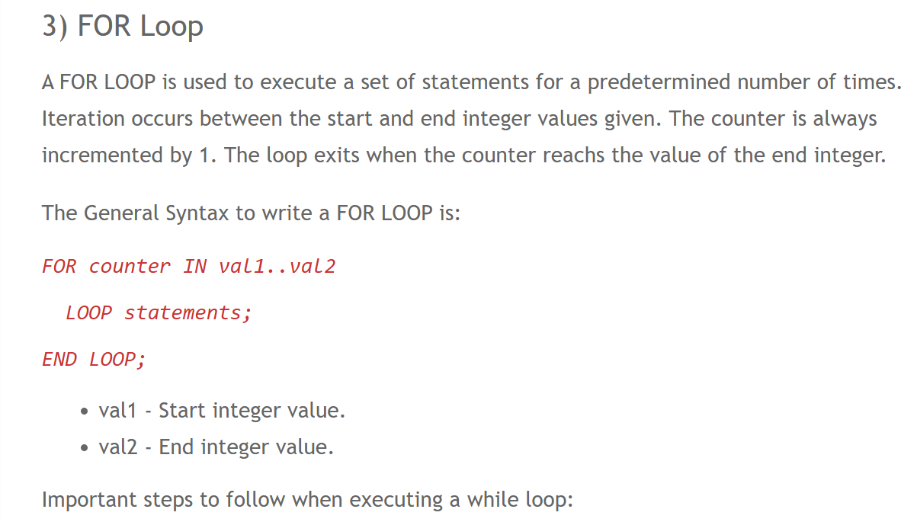

Slide 27
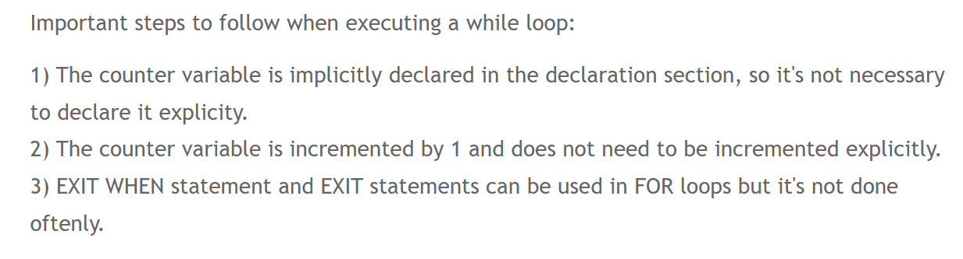

Slide 29
Exception Handling
An exception is defined as a special condition that changes the program execution flow. The PL/SQL provides you with a flexible and powerful way to handle such exceptions.
PL/SQL catches and handles exceptions by using exception handler architecture. Whenever an exception occurs, it is raised. The current PL/SQL block execution halts, control is passed to a separate section called exception section.

Slide 30
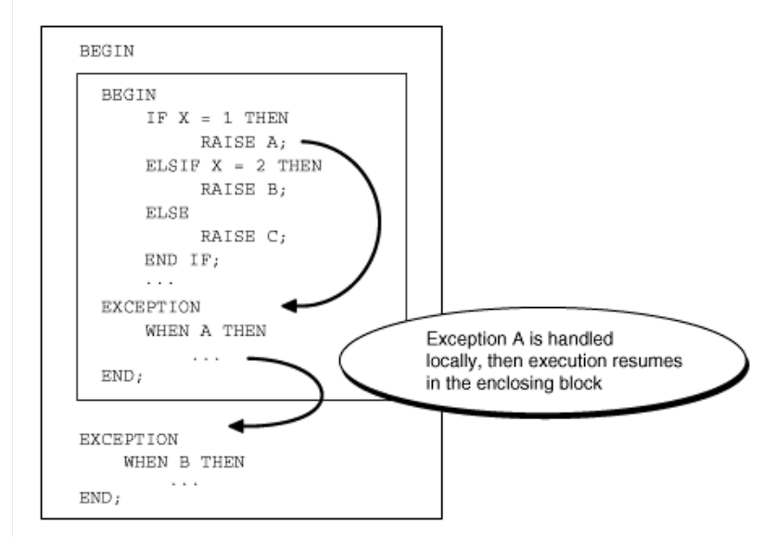

Slide 31
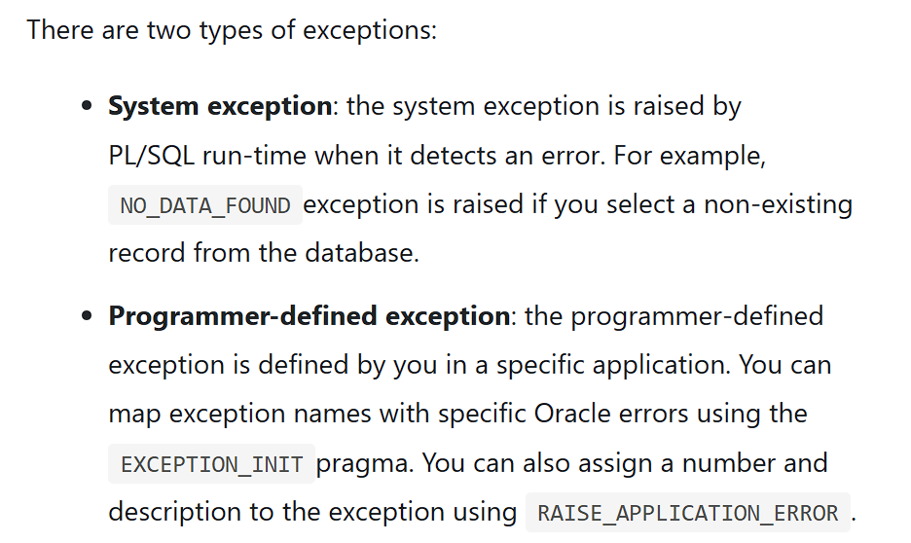

Slide 32
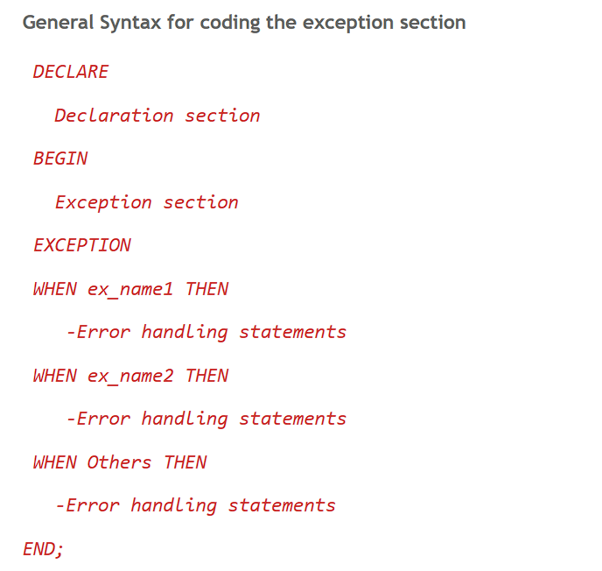

Slide 33
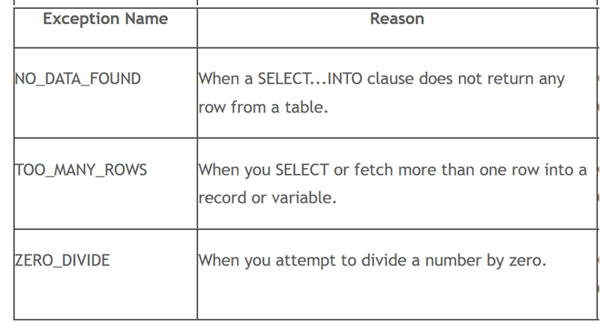

Slide 34
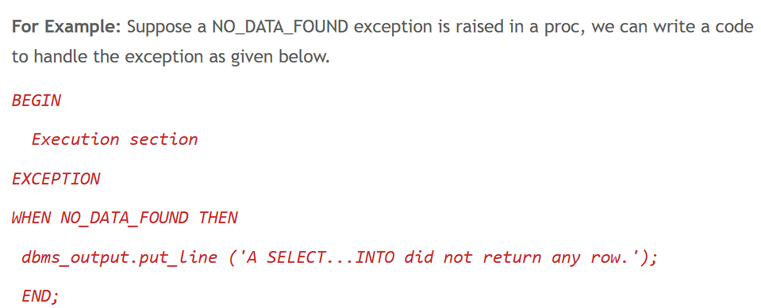

Slide 35
User-defined Exceptions
PL/SQL allows you to define your own exceptions according to the need of your program.
A user-defined exception must be declared and then raised explicitly, using either a RAISE statement or the procedure DBMS_STANDARD.RAISE_APPLICATION_ERROR.
The syntax for declaring an exception is −
DECLARE my-exception EXCEPTION;

Slide 36
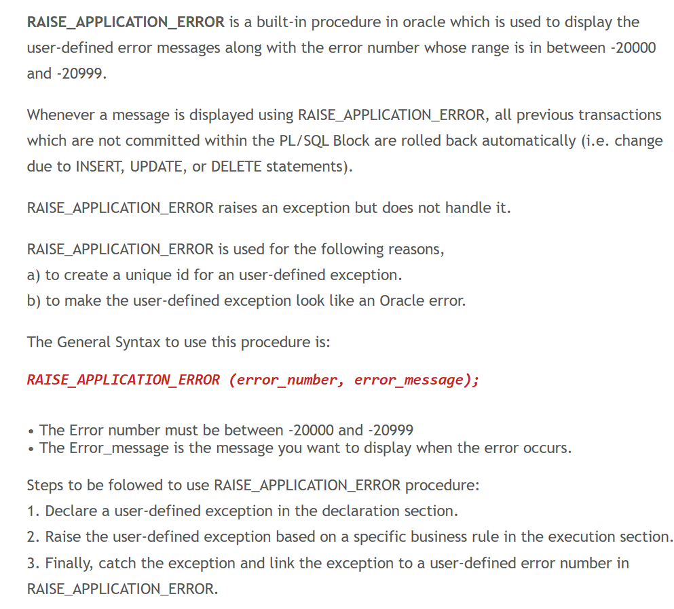

Slide 37
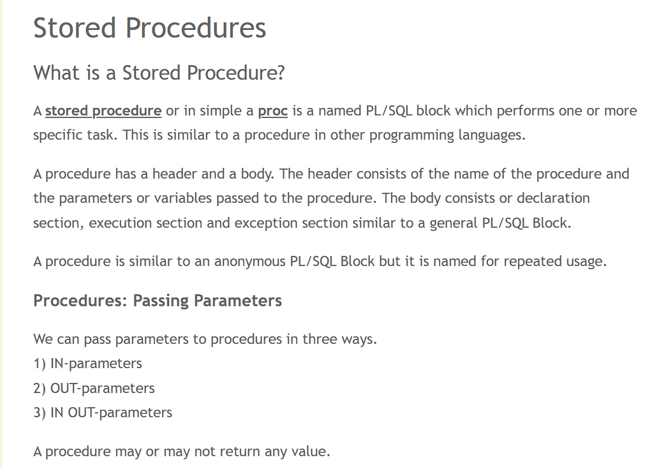

Slide 38
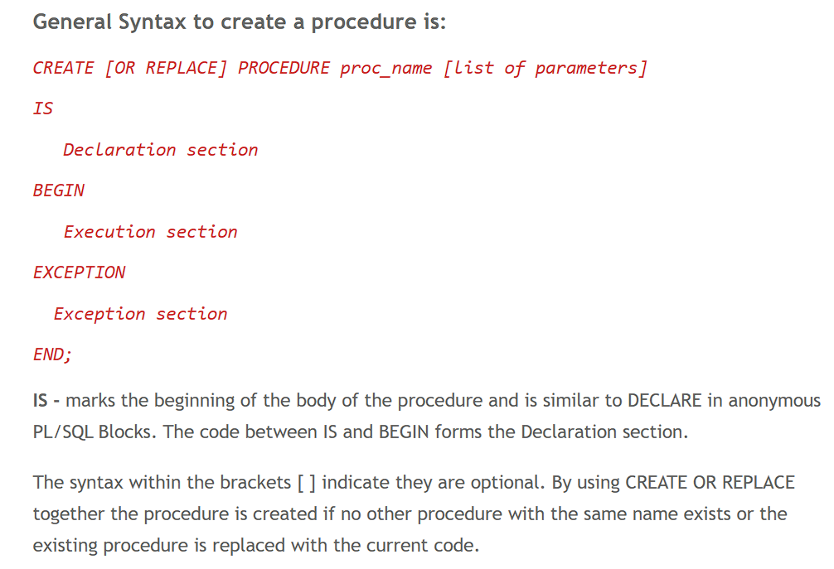

Slide 39
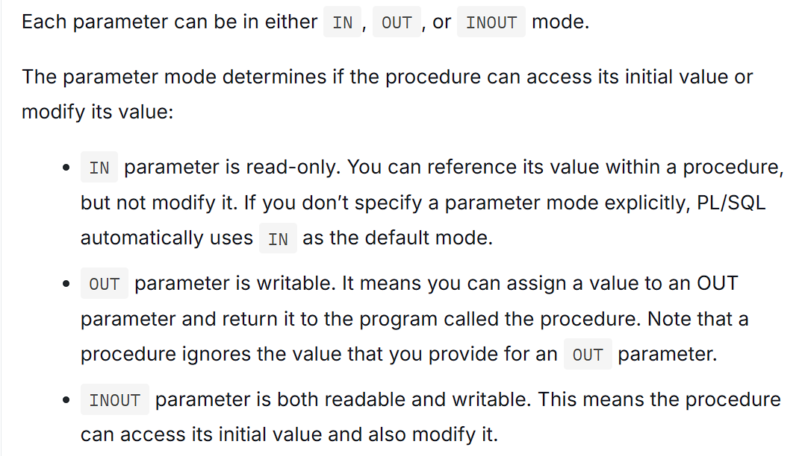

Slide 40
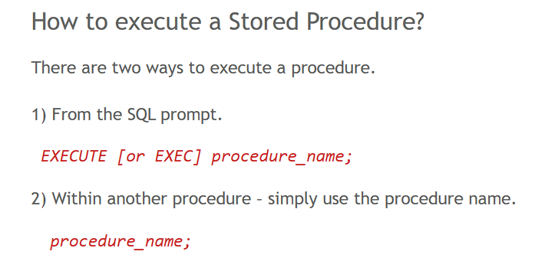

Slide 41
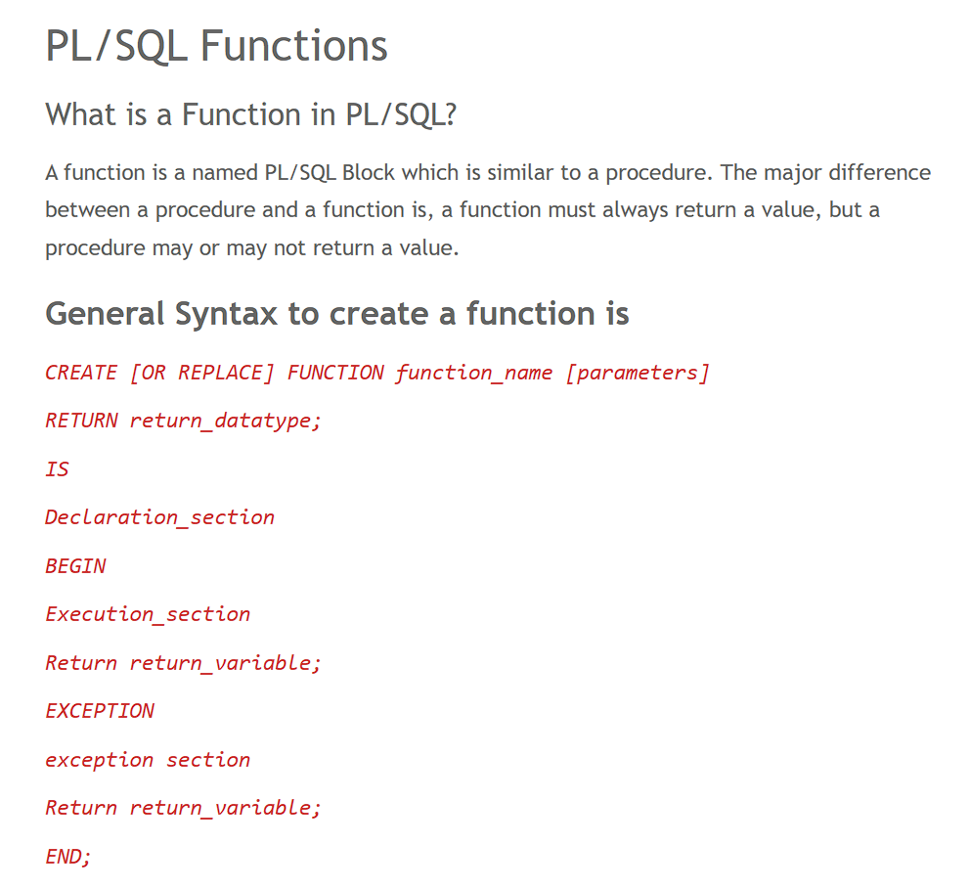

Slide 43
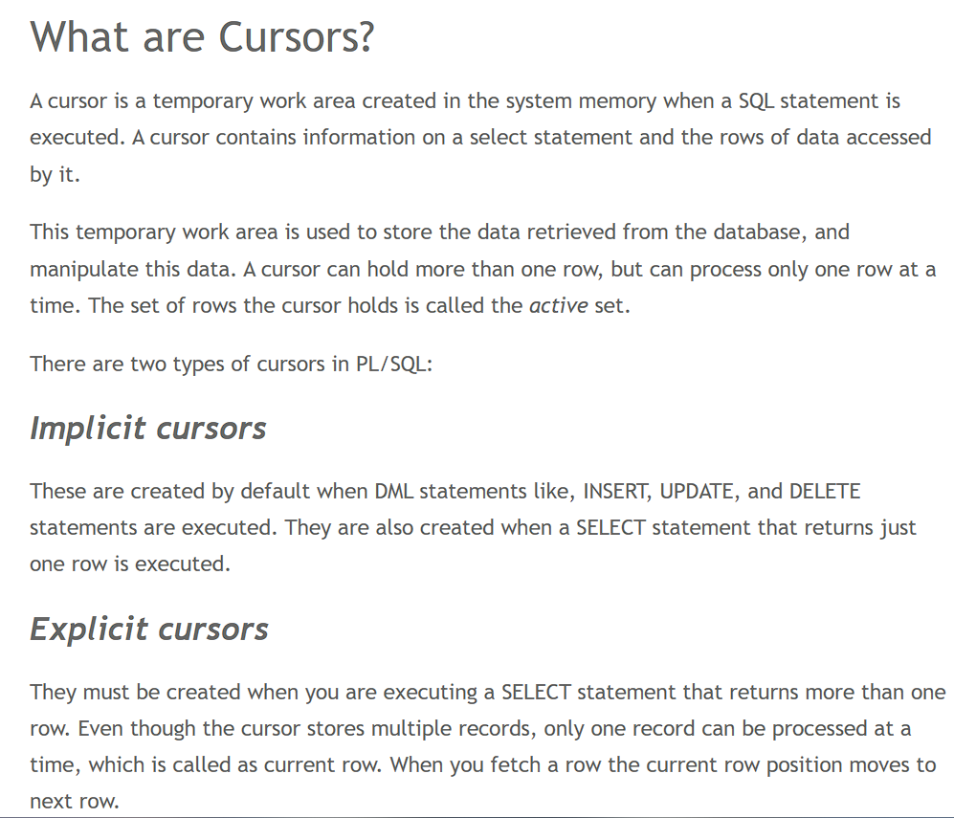

Slide 44
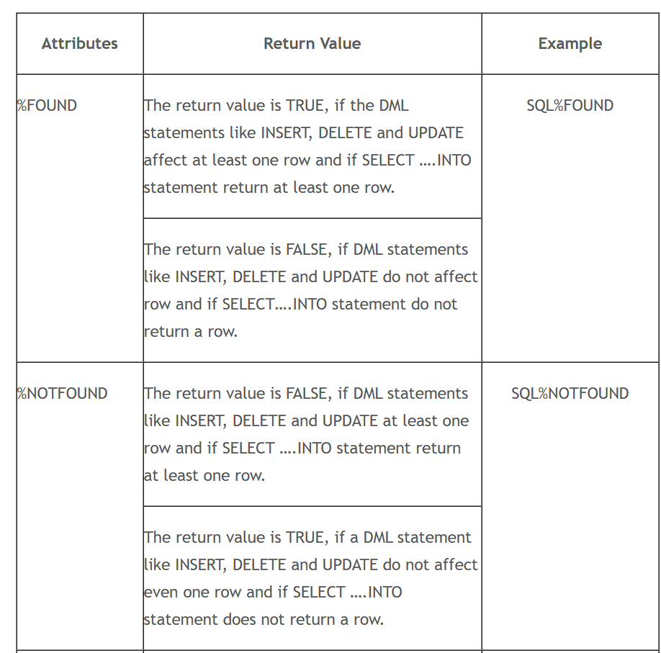

Slide 45
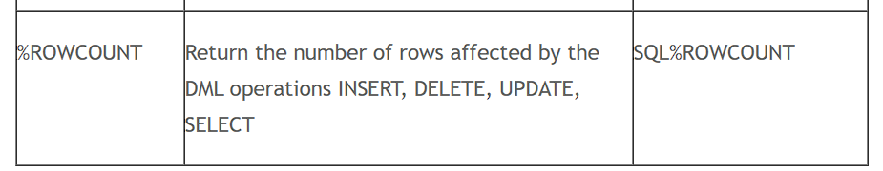

Slide 46
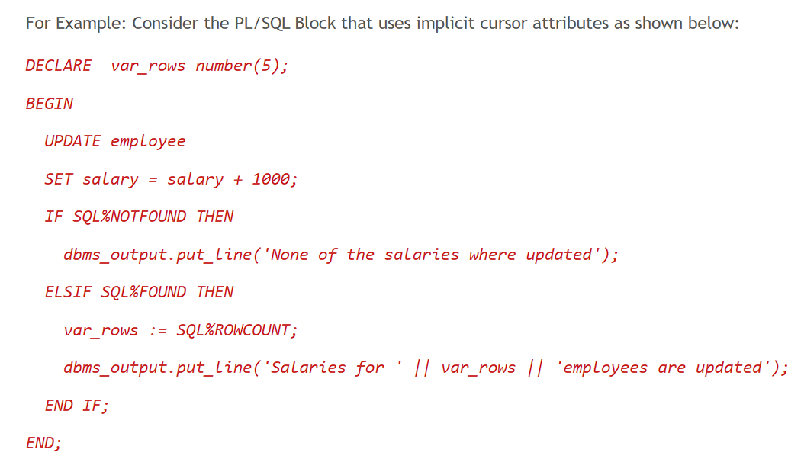

Slide 47
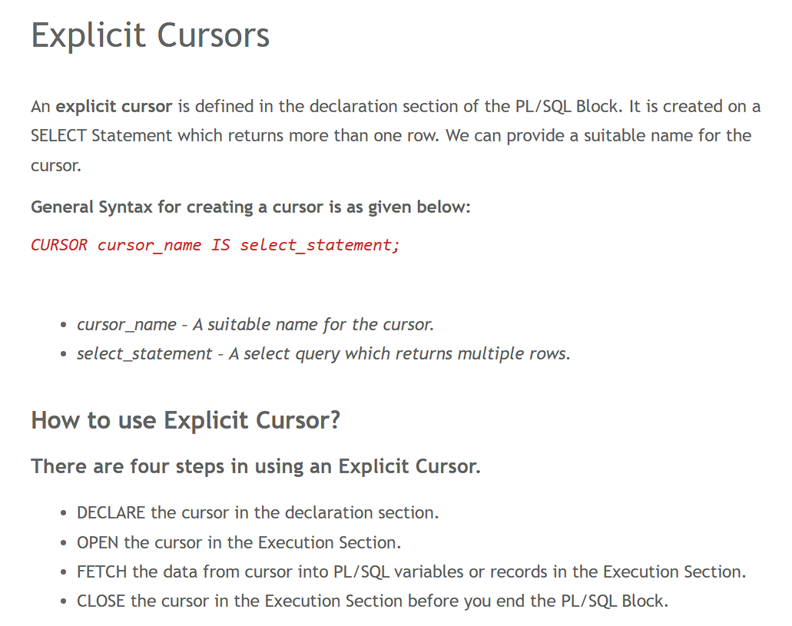

Slide 48
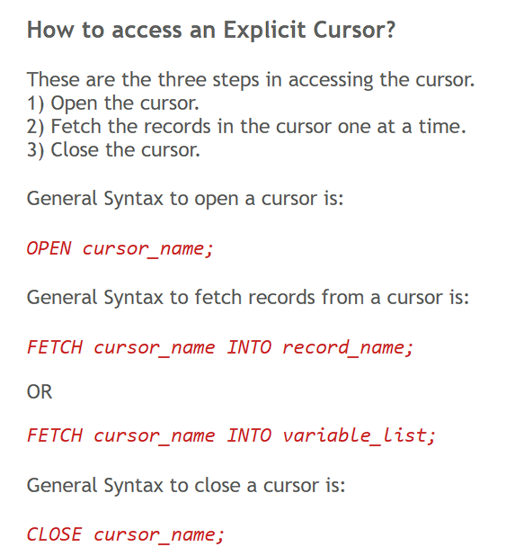

Slide 49
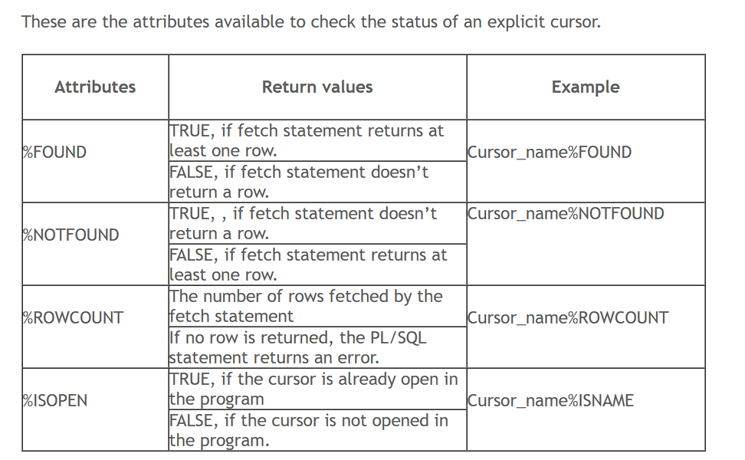

Slide 51
Packages
PL/SQL package is a group of related functions, procedures, types, cursors, etc.
PL/SQL package is like a library once written stored in the Oracle database and can be used by many applications.
A PL/SQL package has two parts: package specification and package body.
A package specification is the public interface of applications.
The public means the stored function, procedures, types, etc., are accessible from other applications.
A package body contains the code that implements the package specification.

Slide 52
What is a Trigger?
A trigger is a pl/sql block structure which is fired when a DML statements like Insert, Delete, Update is executed on a database table.
A trigger is triggered automatically when an associated DML statement is executed.

Slide 53
1. Create Package Specification :
syntax:
Create or replace package package-name is
declaration of Procedures /Functions/cursors
end package-name;
2. Create Package body
syn:
create or replace package body package-name is
implement package specification interfaces
end package-name;
3. To Call :
Package-name.procedure/function

Slide 54
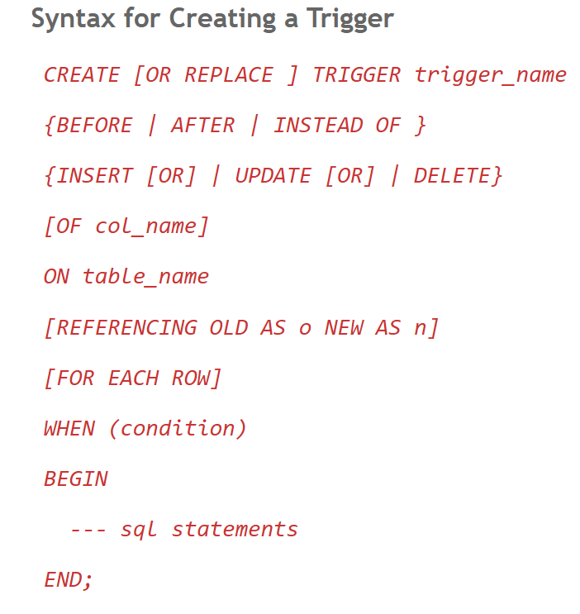

Slide 55
Dynamic SQL in PL/SQL refers to the construction and execution of SQL statements or entire PL/SQL blocks at runtime, rather than having them fully defined and fixed at compile time.
This provides flexibility, allowing programs to adapt to varying conditions or user inputs
EXECUTE IMMEDIATE executes the dynamically built SQL statement.

Slide 56
Dynaic SQL
EXECUTE IMMEDIATE 'dynamic sql comand'
create or replace procedure drop_table(n in varchar2)is
begin
EXECUTE IMMEDIATE 'DROP TABLE '||n;
end;
/
create or replace procedure drop_object(t in varchar2, n in varchar2)
is
begin
EXECUTE IMMEDIATE 'DROP '||t||' '||n;
end;
/
EXECUTE DROP_OBJECT('SEQUENCE','S1');

